Slide 1
Research: A Way of Thinking
Kumar: Research Methodology
Chapter 1
Prepared by Stephanie Fleischer
authored by Stephanie Fleischer © SAGE publications Ltd 2014

Slide 2
Topics covered
Reasons for doing research
How evidence from research can inform practice
Applications of research
Characteristics and requirements of research process
Types of research
Mixed methods approach
Paradigms of research
authored by Stephanie Fleischer © SAGE publications Ltd 2014

Slide 3
Reasons for doing research
To understand a field you are studying/working in
To explain and find answers in relation to what you perceive
To critically examine certain aspects
To make changes
To find answers to theoretical questions
authored by Stephanie Fleischer © SAGE publications Ltd 2014

Slide 4
How evidence from research can inform practice
Decision makers use evidence to improve services or make processes more effective
Evidence-based practice is used to collect information to determine the appropriateness of practice taking into account:
Evidence to deliver process/services effectively
Critical judgement of service providers on suitability and appropriateness
Consumer experience or preference
authored by Stephanie Fleischer © SAGE publications Ltd 2014

Slide 5
Application of research
Examine your own field
Methodologists have developed research methods to understand your specific area
There are many different procedures and techniques
Reliability and validity depends on the soundness of the research methods adopted
authored by Stephanie Fleischer © SAGE publications Ltd 2014

Slide 6
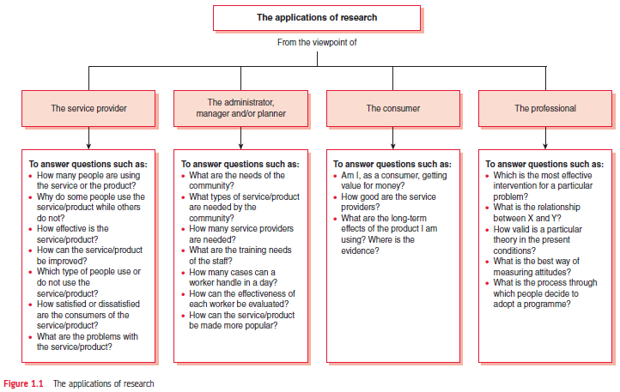
Figure 1.1 The applications of research
authored by Stephanie Fleischer © SAGE publications Ltd 2014

Slide 7
Research: What does it mean?
“Research is a structured inquiry that utilises acceptable scientific methodology to solve problems and creates new knowledge that is generally applicable.” (Grinnell 1993:4)
“a systematic investigation to find answers to a problem” (Burns, 1997:2)
authored by Stephanie Fleischer © SAGE publications Ltd 2014

Slide 8
Characteristics and requirements of research process
Collecting, analysing and interpretation of information to answer questions must require certain characteristics:
Controlled
Rigorous
Systematic
Valid and verifiable
Empirical
Critical
authored by Stephanie Fleischer © SAGE publications Ltd 2014

Slide 9
Types of research
Mode of enquiry to find answers to a research problem underpinned by different philosophies:
Quantitative approach or the structured approach
Qualitative approach or the unstructured approach
Mixed methods approach
The choice of approach depends on
Aim of enquiry – exploration, confirmation or quantification.
Use of the findings – policy formulation or process understanding.
authored by Stephanie Fleischer © SAGE publications Ltd 2014

Slide 10
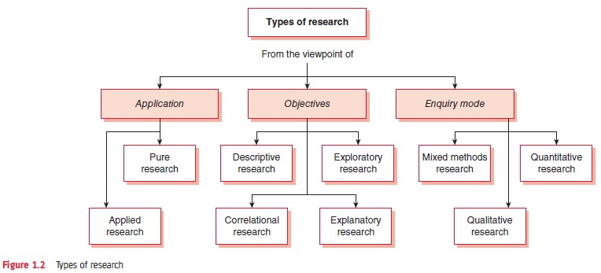
Figure 1.2 Types of research
authored by Stephanie Fleischer © SAGE publications Ltd 2014

Slide 11
The mixed methods approach
Combine multiple methods of different paradigms (quantitative /qualitative ) to improve findings
Advantages:
Enhances research possibilities
Better for more complex situations
Enrichment of data
Collecting additional research evidence
Disadvantages:
More data means more work and resources
Requires additional and diverse skills
Contacting two study populations
Resolving disagreements in data
authored by Stephanie Fleischer © SAGE publications Ltd 2014

Slide 12
Paradigms of research
Form the basis of research methodology
Quantitative approach (systematic, scientific or positivist approach to social enquiry)
Qualitative approach (ethnographic, ecological or naturalistic approach)
Mixed methods approach (combination of quantitative and qualitative approach)
authored by Stephanie Fleischer © SAGE publications Ltd 2014

Slide 13
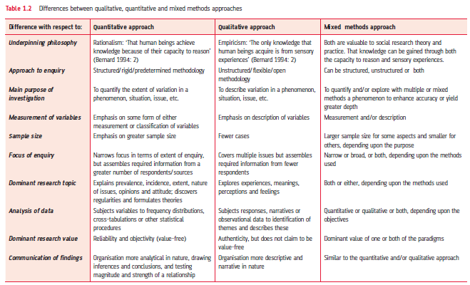
Table 1.2 Differences between qualitative, quantitative and mixed methods approaches
authored by Stephanie Fleischer © SAGE publications Ltd 2014

